Slide 1
Extended Entity Relationship Model
Lecture 4

Slide 2
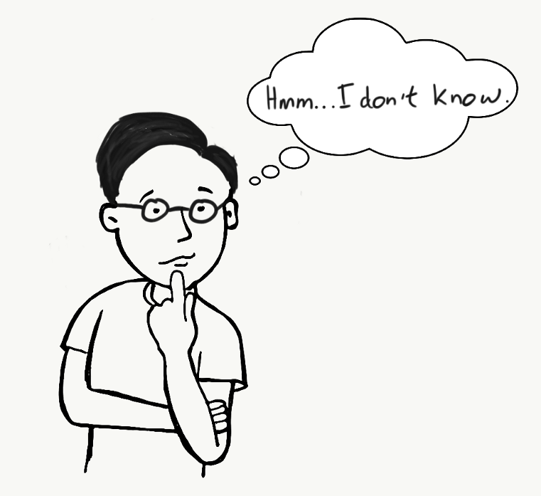
Why EER??
THE ENTITY RELATIONSHIP MODEL IN ITS ORIGINAL FORM DID NOT SUPPORT THE SPECIALIZATION/ GENERALIZATION ABSTRACTIONS

Slide 3
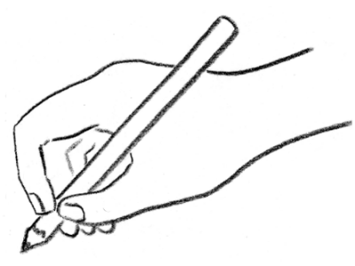
Extended Entity Relationship (EER) Model
EER is a high-level data model that incorporates the extensions to the original ER model.
It is a diagrammatic technique for displaying the following concepts
Sub Class and Super Class
Specialization and Generalization
Union or Category
Aggregation

Slide 4
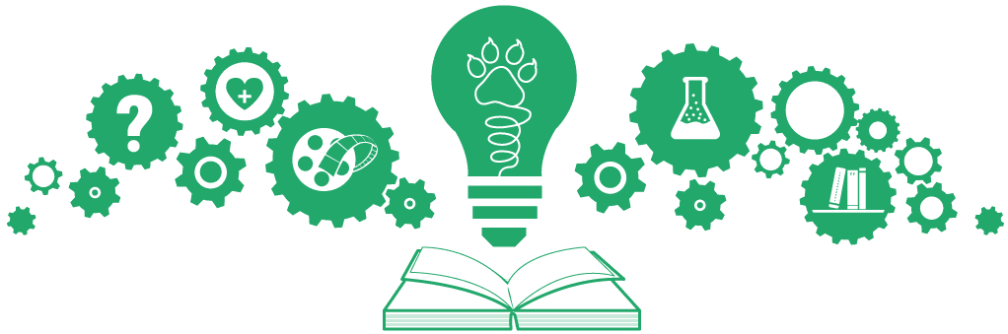
Subclasses & Superclasses
An entity type may have additional meaningful subgroupings of its entities
Example: EMPLOYEE may be further grouped into:
SECRETARY, ENGINEER, TECHNICIAN
(Based on the EMPLOYEE’s Job)
MANAGER
(EMPLOYEEs who are managers)
SALARIED_EMPLOYEE, HOURLY_EMPLOYEE
(Based on the EMPLOYEE’s method of pay)

Slide 5
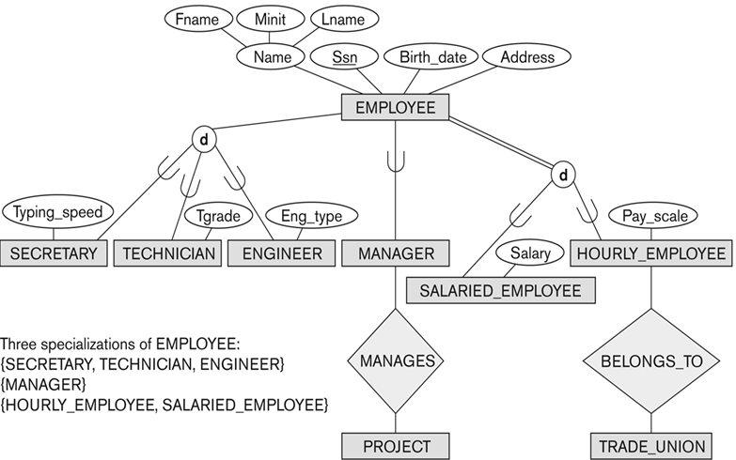
Example – Subclass & Superclass
Subclass
Superclass

Slide 6

Subclass & Superclass (Cont.)
The Superclass-subclass relationship is also called IS-A relationship
Example: SECRETARY IS-A EMPLOYEE, TECHNICIAN IS-A EMPLOYEE
Note: An entity that is member of a subclass represents the same real-world entity as some member of the superclass:
The subclass member is the same entity in a distinct specific role
An entity cannot exist in the database merely by being a member of a subclass; it must also be a member of the superclass
A member of the superclass can be optionally included as a member of any number of its subclasses

Slide 7
Example - Subclass & Superclass
A salaried employee who is also an engineer belongs to the two subclasses:
ENGINEER, and
SALARIED_EMPLOYEE
A salaried employee who is also an engineering manager belongs to the three subclasses:
MANAGER,
ENGINEER, and
SALARIED_EMPLOYEE
It is not necessary that every entity in a superclass be a member of some subclass

Slide 8
Example – Subclass & Superclass
Subclass
Superclass

Slide 9
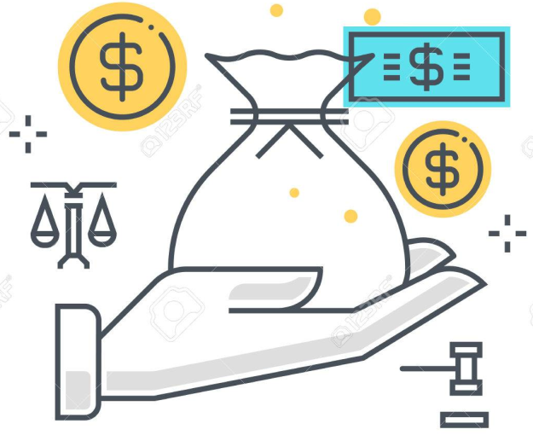
Attribute Inheritance in Superclass/ Subclass Relationships
An entity that is member of a subclass inherits
All attributes of the entity as a member of the superclass
All relationships of the entity as a member of the superclass
Example: SECRETARY (as well as
TECHNICIAN and ENGINEER) inherit
the attributes Name, SSN, …,
from EMPLOYEE

Slide 10

Specialization
Specialization is the process of defining a set of subclasses of a superclass
The set of subclasses is based upon some distinguishing characteristics of the entities in the superclass
Example: {SECRETARY, ENGINEER, TECHNICIAN} is a specialization of EMPLOYEE based upon job type.
May have several specializations of the same superclass

Slide 11
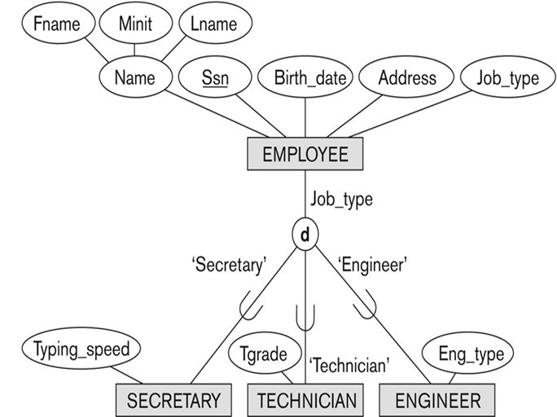
Representing Specialization – Attribute Defined on Job-type

Slide 12

Specialization (Cont.)
Example: Another specialization of EMPLOYEE based on method of pay is {SALARIED_EMPLOYEE, HOURLY_EMPLOYEE}.
Attributes of a subclass are called specific or local attributes.
For example, the attribute TypingSpeed of SECRETARY
The subclass can also participate in specific relationship types.
For example, a relationship BELONGS_TO of HOURLY_EMPLOYEE

Slide 13
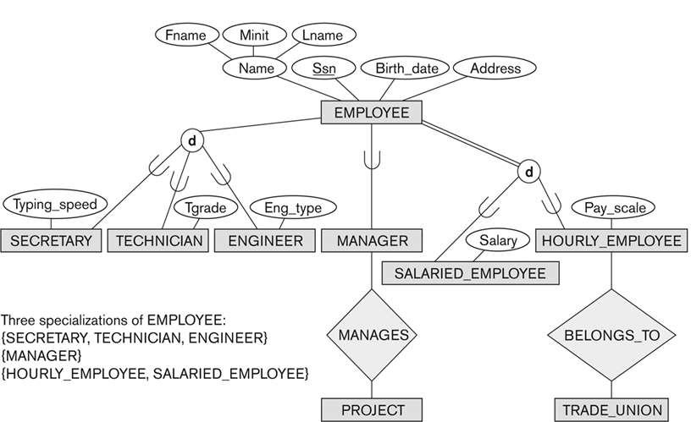
Specialization (Cont.)

Slide 14
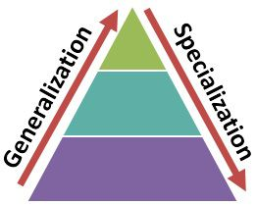
Generalization
Generalization is the reverse of the specialization process
Several classes with common features are generalized into a superclass (original classes become its subclasses)
Example: CAR, TRUCK generalized into VEHICLE;
both CAR, TRUCK become subclasses of the superclass VEHICLE.
We can view {CAR, TRUCK} as a specialization of VEHICLE
Alternatively, we can view VEHICLE as a generalization of CAR and TRUCK

Slide 15
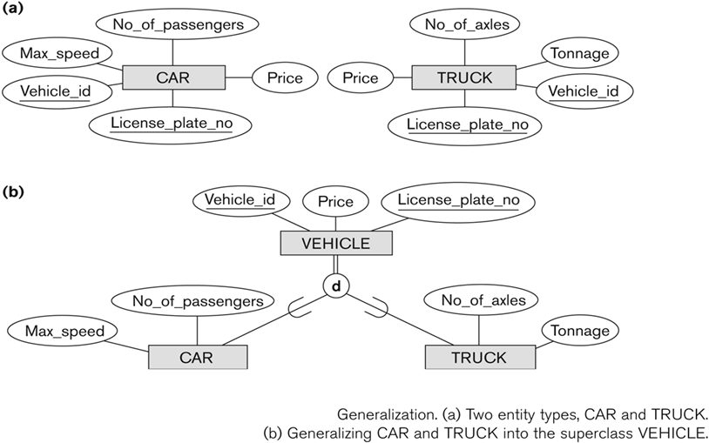
Generalization Example

Slide 16

Data Modeling – Generalization & Specialization
A superclass or subclass represents a collection (or set or grouping) of entities
It also represents a particular type of entity
We can call all entity types (and their corresponding collections) classes, whether they are entity types, superclasses or subclasses

Slide 17
Constraints on Specialization & Generalization
If we can determine exactly those entities that will become members of each subclass by a condition, the subclasses are called predicate-defined (or condition-defined) subclasses
Condition is a constraint that determines subclass members
Display a predicate-defined subclass by writing the predicate condition next to the line attaching the subclass to its superclass

Slide 18
Constraints on Specialization & Generalization (Cont.)
If all subclasses in a specialization have membership condition on same attribute of the superclass, specialization is called an attribute-defined specialization
Example: JobType is the defining attribute of the specialization {SECRETARY, TECHNICIAN, ENGINEER} of EMPLOYEE
If no condition determines membership, the subclass is called user-defined specialization
Membership in a subclass is determined by the database users by applying an operation to add an entity to the subclass
Membership in the subclass is specified individually for each entity in the superclass by the user

Slide 19
Attribute Defined Specialization – Job-type

Slide 20
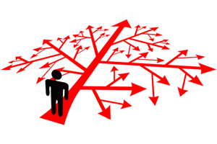
Constraints on Specialization & Generalization (Cont.)
Two basic constraints can apply to a specialization/generalization:
Disjointness Constraint
Completeness Constraint

Slide 21
Constraints on Specialization & Generalization (Cont.)
Disjointness Constraint:
Specifies that the subclasses of the specialization must be disjoint i.e. an entity can be a member of at most one of the subclasses of the specialization
Specified by d in EER diagram
Overlapping Constraint:
If not disjoint, specialization is overlapping i.e. the same entity may be a member of more than one subclass of the specialization
Specified by o in EER diagram

Slide 22
COMPLETENESS Constraints - Specialization & Generalization
Total specifies that every entity in the superclass must be a member of some subclass in the specialization/generalization
Shown in EER diagrams by a double line
Partial allows an entity not to belong to any of the subclasses
Shown in EER diagrams by a single line

Slide 23
Constraints on Specialization & Generalization
Specialization/ Generalization
Disjoint, Total
Disjoint, Partial
Overlapping, Total
Overlapping, Partial
Note: Generalization usually is total because the superclass is derived from the subclasses.

Slide 24
Example of Disjoint Partial Specialization

Slide 25
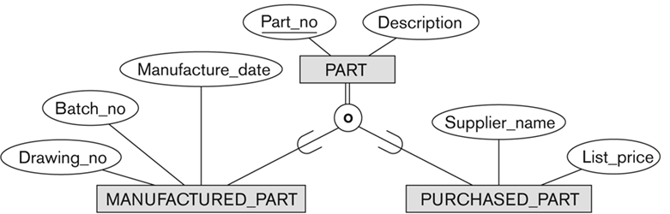
Example of Overlapping Total Specialization

Slide 26
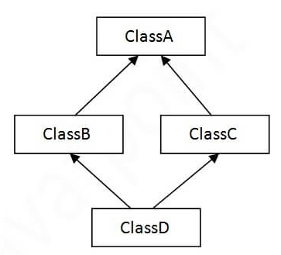
Specialization/Generalization - Hierarchies, Lattices & Shared Subclasses
A subclass may itself have further subclasses specified on it i.e. Hierarchy or Lattice
Hierarchy has a constraint that every subclass has only one superclass (called single inheritance); this is basically a tree structure
In a lattice, a subclass can be subclass of more than one superclass (called multiple inheritance)

Slide 27
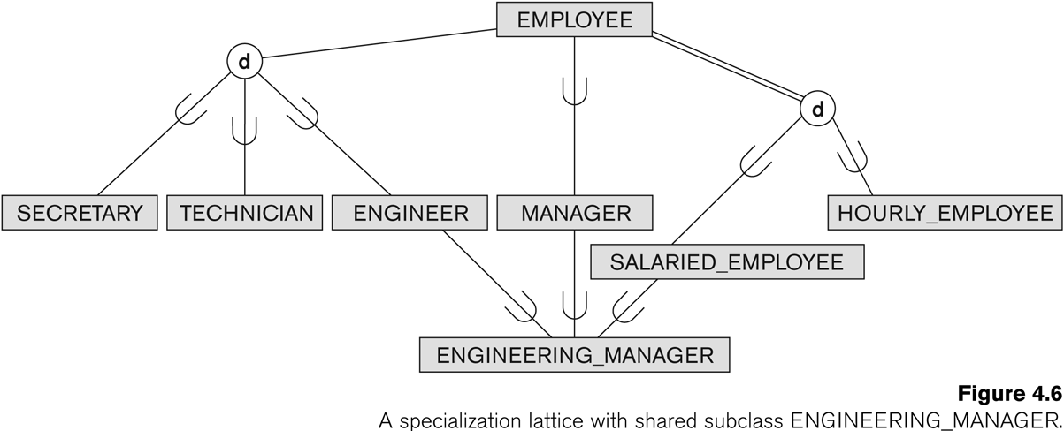
Shared Subclass “Engineering_Manager” (Lattice)

Slide 28
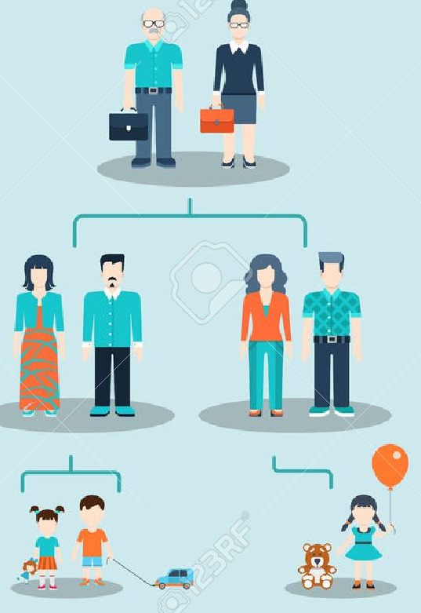
Specialization/Generalization - Hierarchies, Lattices & Shared Subclasses
In a lattice or hierarchy, a subclass inherits attributes not only of its direct superclass, but also of all its predecessor superclasses
A subclass with more than one superclass is called a shared subclass (multiple inheritance)
specialization hierarchies or lattices, or
generalization hierarchies or lattices,

Slide 29
Specialization/Generalization - Hierarchies, Lattices & Shared Subclasses
In specialization, start with an entity type and then define subclasses of the entity type by successive specialization
called a top down conceptual refinement process
In generalization, start with many entity types and generalize those that have common properties
called a bottom up conceptual synthesis process
In practice, a combination of both processes is usually employed

Slide 30
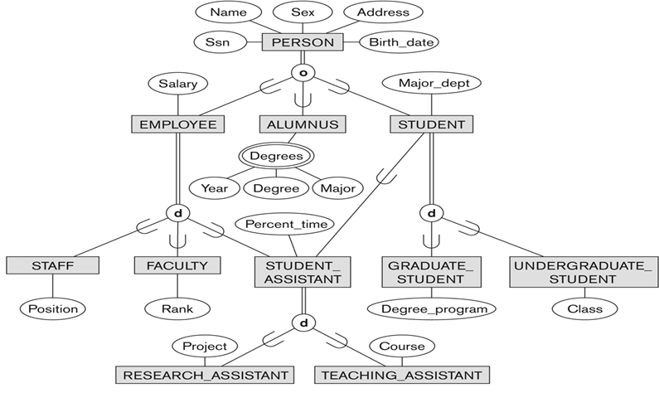
Example - Specialization/ Generalization Lattice (UNIVERSITY)

Slide 31

Categories (UNION Type)
All of the superclass/subclass relationships we have seen thus far have a single superclass
A shared subclass is a subclass in:
more than one distinct superclass/ subclass relationships
shared subclass leads to multiple inheritance
In some cases, we need to model a single superclass/ subclass relationship with more than one superclass
Such a subclass is called a category or UNION Type

Slide 32
Example - Categories (UNION Type)
In a database for vehicle registration, a vehicle owner can be a PERSON, a BANK (holding a lien on a vehicle) or a COMPANY.
A category (UNION type) called OWNER is created to represent a subset of the union of the three superclasses COMPANY, BANK, and PERSON
A category member must exist in at least one of its superclasses
Difference from shared subclass, which is a:
subset of the intersection of its superclasses
shared subclass member must exist in all of its superclasses

Slide 33
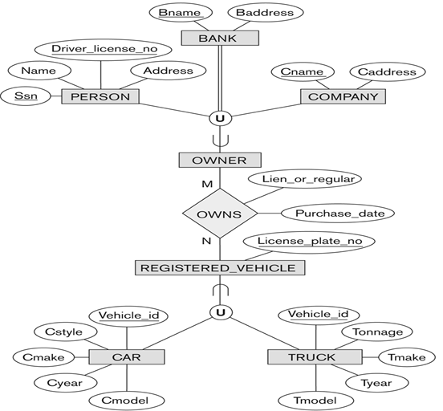
Two categories (UNION types): OWNER, REGISTERED_VEHICLE

Slide 34
Categories (UNION Type) Cont.
Attribute Inheritance works more selectively in case of categories in comparison to a shared subclass (inherit all attributes of all superclasses).
A total category holds union of all entities in its superclasses. Represented by double line
A partial category can hold a subset of the union. Represented by single line

Slide 35
Thanks!!

